Slide 1
Business Models & Value Propositions Paul Field MSc

Slide 2
Content
Business model canvas (Alex Osterwalder – strategizer)
Value propositions
USPs
Death of the business plan?

Slide 4
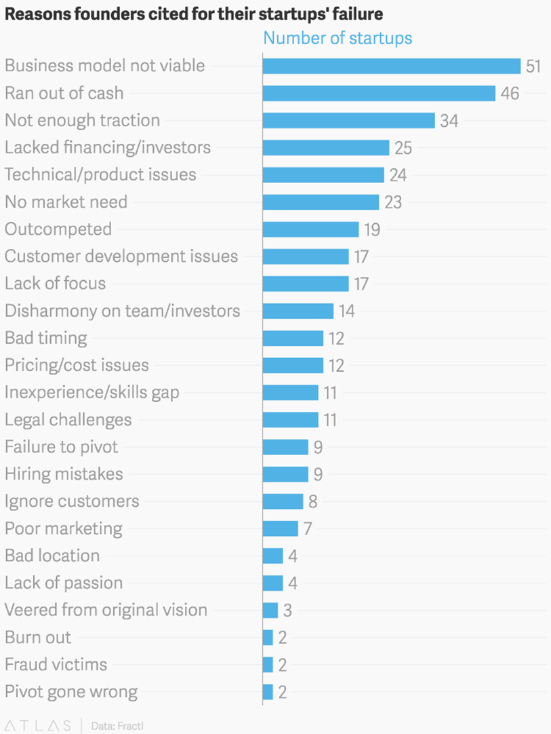
Why do BMs Matter?

Slide 5
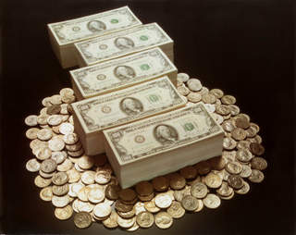
Business Model Definition
Rationale of how organisations create, deliver, capture value. Its the logic of how a company intends to make money £££££££££££$$$$$$$$$$$$$$£££££££££££

Slide 6
Mistakes
You search for the perfect idea
You mistake your hallucination for a vision
You fall in love with your first idea
You focus on product & technologies at the expense of a business model
You obsess over competitors, not customers
You first focus on 'can it be built' instead of 'should it be built‘
You build what customers say they want
Bad timing

Slide 7
7 considerations for your model
How scalable is your business model?
Does your business model produce recurring revenues?
Do you earn before you spend?
How much do you get others to do the work?
Does your business model provide built-in protection from competition?
Is your business model based on a game changing cost structure?
How much do switching costs prevent your customers from churning?
Notes:
Apple storage, plugs – software – newspaper v Saas – Dell - IKEA – Apple app store - skype -

Slide 8
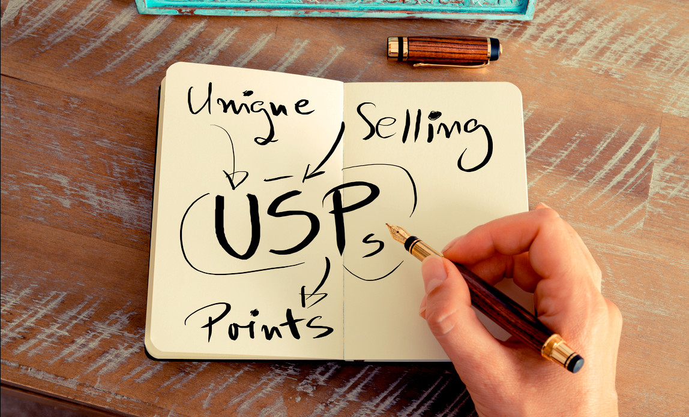
Differentiator
USP ???
- Unique selling point

Slide 9
BMC Template

Slide 10
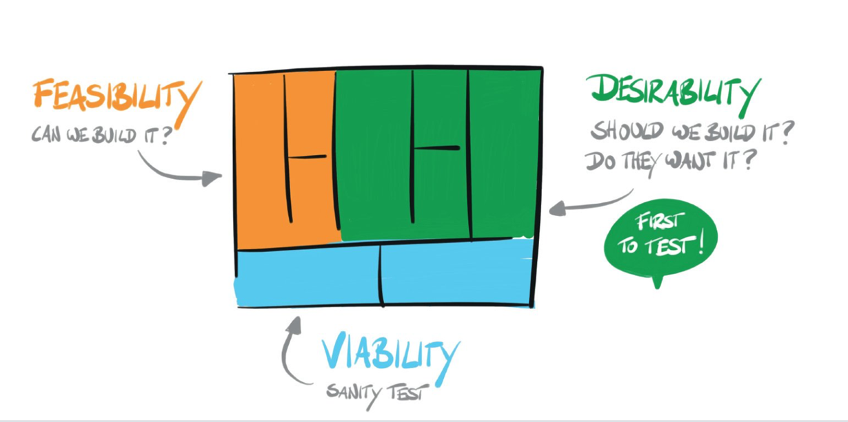
Sanity Check - Storyboard

Slide 11
Business Model Canvas
Value Propositions
Customer Relationships
Customer Segments
V
Key Partnerships
Key Activities
T-shirt suppliers
Managing Stock
Managing stock
Trendy t-shirts for kids
Fashion conscious parents
Selecting t-shirts
Personal in-store advice
Sales
Key Resources
Channels
High street store
Store location
www
Sales people
Desirable t-shirt inventory
Word of mouth
Google AdWords
Cost Structure
Revenue Streams
Sales team
T-shirt sales
Purchase of t-shirts
Ad budget
Store rental
businessmodelgeneration.com

Slide 12
What do you actually do?

Slide 13
Value Proposition
This is the reason that customers turn to your company over another. It solves a problem or satisfies a need.
Ask yourself:
What problems are you helping to solve
Which job are you helping the customer get done
What customer needs are you satisfying
How does your offer differ for each customer segment
What are you delivering to the customer
Trendy t-shirts for kids

Slide 14
Customers

Slide 15
Customer Segment
Different groups of people or organizations you are trying to reach and serve. Without customers, your company cannot survive.
Ask yourself:
What are your types of customers
How does each type differ
Do they need a different relationship model or channel of communication
Do they have different profitability
Which customer segment(s) do you serve and which do you ignore or come back to later
Who are the most important customers
Fashion conscious parents

Slide 16
Customer Relationships
The relationship with each specific customer segment established through your different channels
Ask yourself:
What does each customer type expect
What is the cost
Which ones do you have already
Personal in-store advice

Slide 17
Channels
Communications with customers and potential customers.
Ask yourself:
How are they integrated
Which are most cost effective
What works best for each customer segment
High street store
Word of mouth
www
Google AdWords

Slide 18
Tasks and Resources

Slide 19
Key Activities
What do you need to do to operate successfully?
Ask yourself:
What does each distribution channel need
What does each customer relationship need
What does each revenue stream need
What does value proposition type need
Selecting t-shirts
Managing stock
Sales

Slide 20
Key Resources
What do your most important assets need to make your company work?
Ask yourself:
What does value proposition type need
What does each distribution channel need
What does each customer relationship need
What does each revenue stream need
Sales people
Store location
Desirable t-shirt inventory

Slide 21
Key Partnerships
The network of suppliers and partners that make your company work
Ask yourself:
Who are our key partners
Which key resources are we acquiring from partners
Which key activities do partners perform for us
T-shirt suppliers

Slide 22
Costs and Income

Slide 23
Cost Structure
All costs incurred to operate your business
Ask yourself:
What are the most important costs inherent in the business model
Which key resources are most expensive
What key activities are most expensive
Store rental
Purchase of t-shirts
Ad budget
Sales team

Slide 24
Revenue Streams
The ways your company generates income from each customer segment
Ask yourself:
What is each customer segment really willing to pay for what value proposition
How would they prefer to pay
How much does each revenue stream contribute to overall revenues
T-shirt sales

Slide 26
Generating Alternatives

Slide 27
Validation

Slide 28
Value Proposition Characteristics
• Newness
• Performance
• Customization
• “Getting the Job Done”
• Design
• Brand/Status
• Price
• Cost Reduction
• Risk Reduction
• Accessibility
• Convenience/Usability

Slide 29
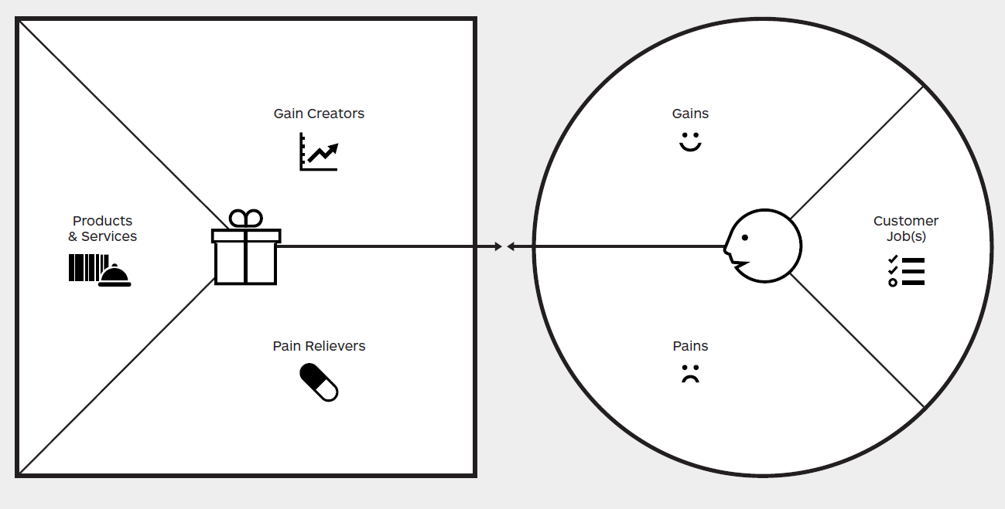
Value Proposition

Slide 30
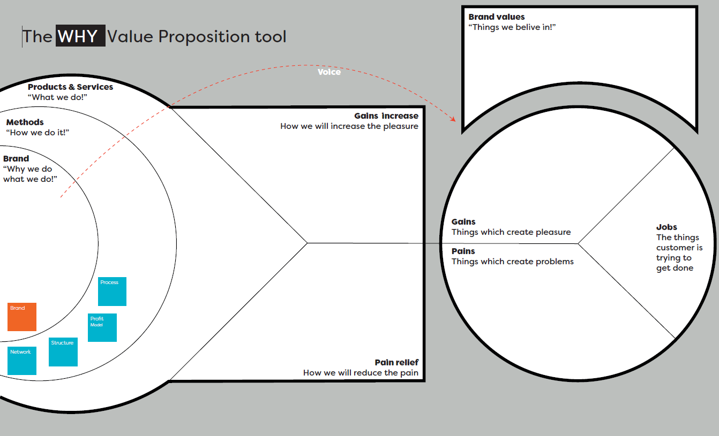
Value Proposition

Slide 31
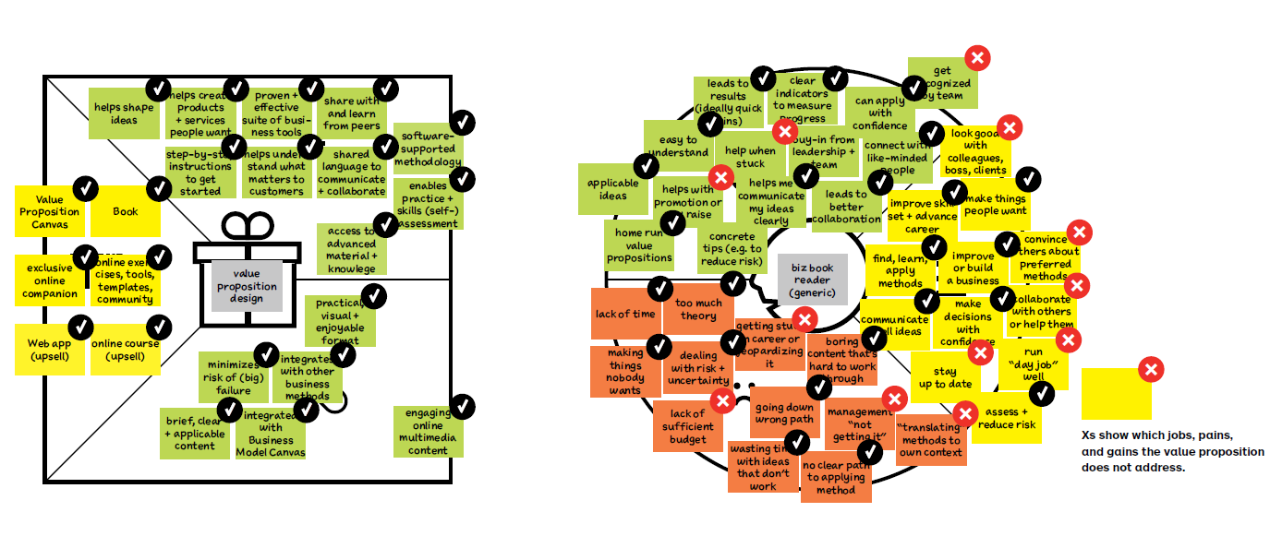
Completed example

Slide 32
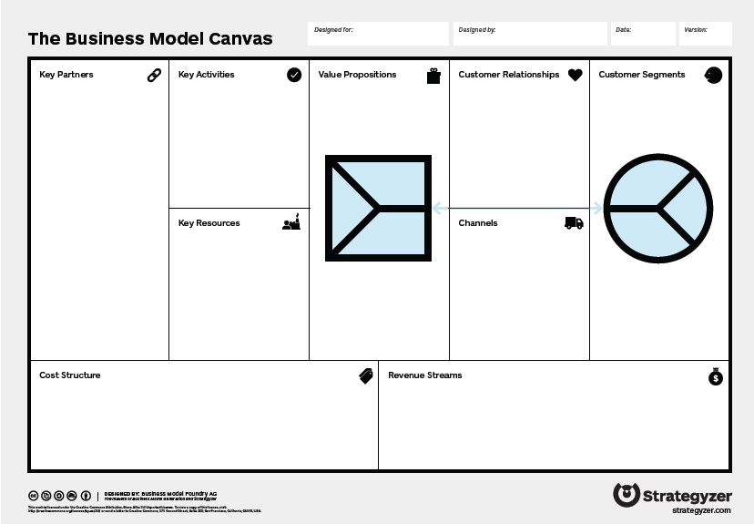

Slide 33
Next steps
To validate business ideas you need to perform many small experiments. At the centre of any one of these experiments should be a deep understanding of the most critical hypotheses and why you are testing them.

Slide 34
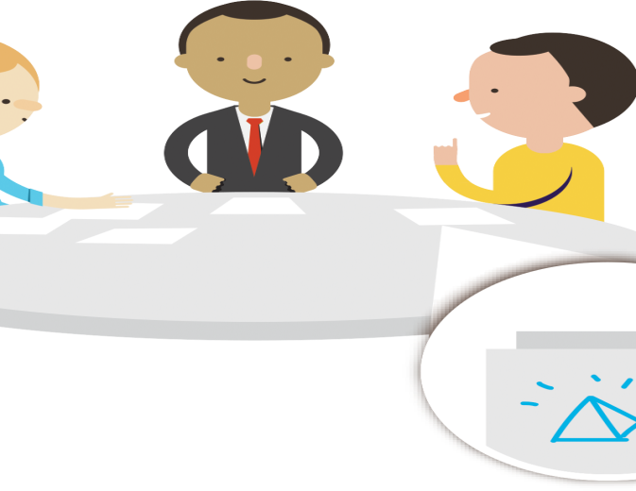
Test your assumptions

Slide 36
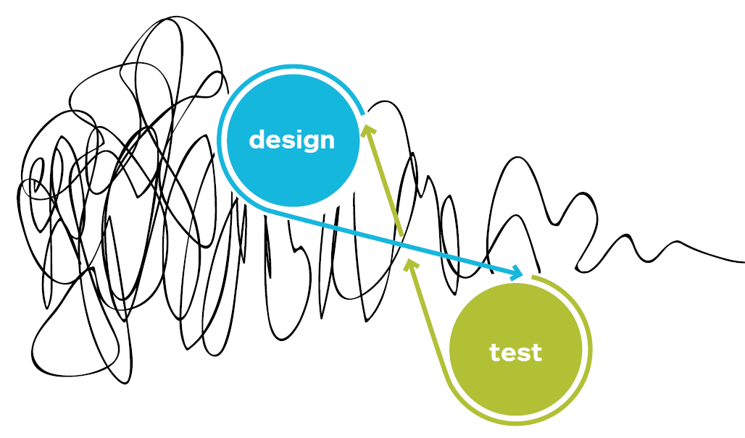
Linear progression?

Slide 37
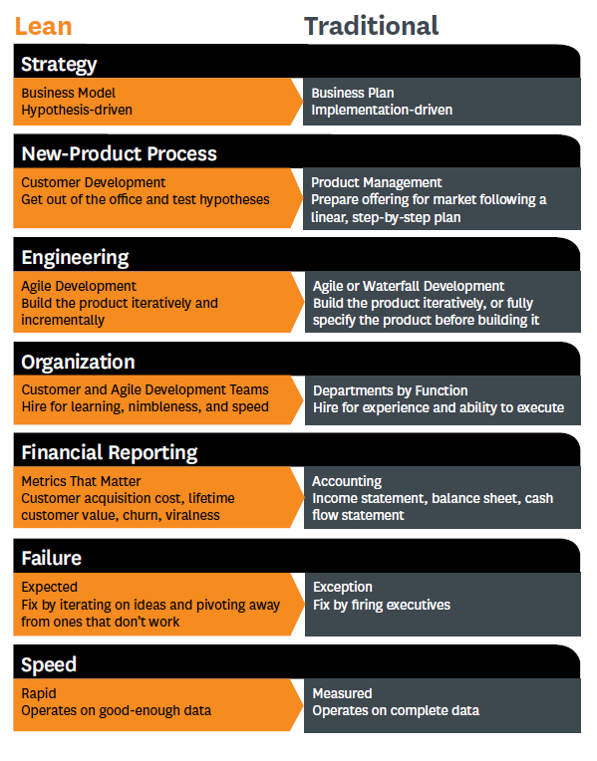

Slide 38
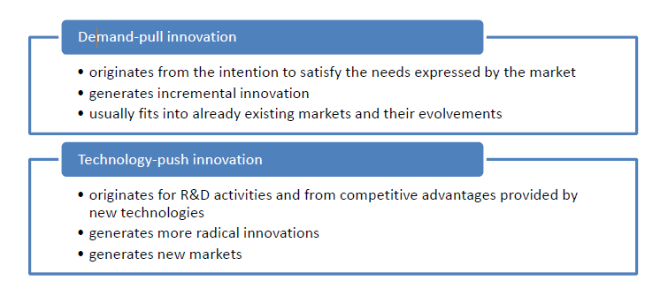
Types of innovation – ethnography?

Slide 39
Monopoly Definition
An ownable space for a useful period of time.
Category benefits - those benefits that customers expect most of the time, and for which, in practice, performance can vary.
Consistently deliver

Slide 40
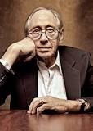
Future Challenge
“The illiterate of the 21st century will not be those who cannot read or write, but those who cannot learn, unlearn and re-learn.”
Alvin Toffler, Futurist

Slide 41
Thank you for listening
Contact : P.Field@hud.ac.uk

