Slide 1
Sino-Swiss
Strategic Innovation Partnerships
Pascal Marmier
CEO swissnex China

Slide 2
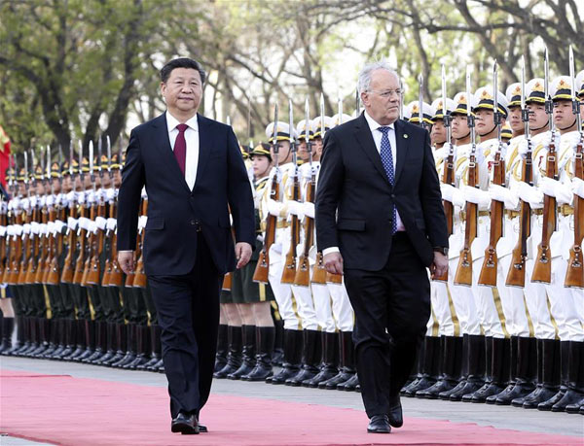

Slide 3
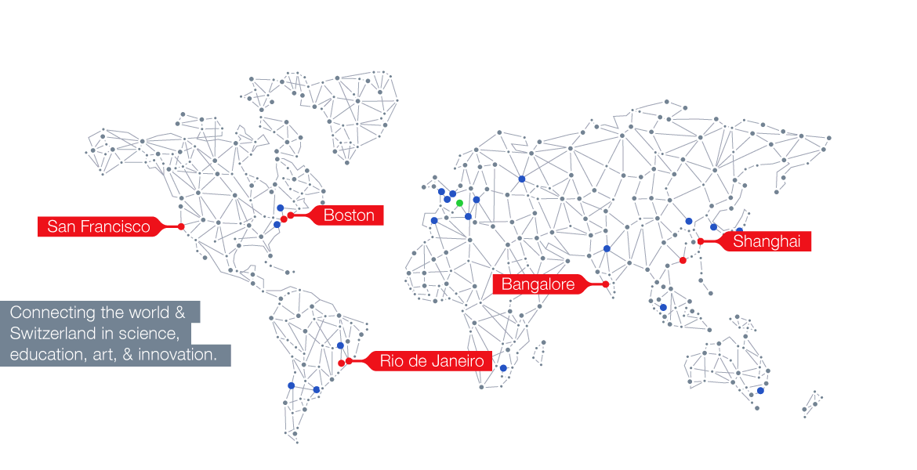
Network of 5 outposts:
Boston (2000)
San Francisco (2003)
Shanghai (2008)
Bangalore (2009)
Rio de Janeiro (2014)
swissnex Background

Slide 4
swissnex China in brief
Implementing SERI strategies in China
Operating under public – private partnership model
“Open source” platform for discussion / ideas
Extended team also in Beijing and Guangzhou
Part of Consulate General in Shanghai (integrated services)

Slide 5
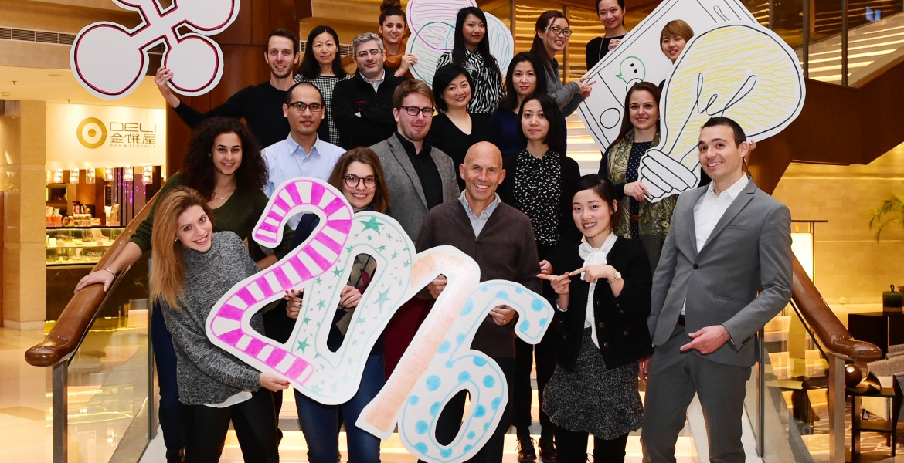
swissnex China team @ Team Retreat 2016

Slide 6
Education

Slide 7
Top 10 most international universities (2016)
Switzerland counts in theirs ranks 4 of the most international universities of the world, a quick glance at how we perform in offering the students the best education possible.

Slide 8
University of applied sciences
9 UAS in Switzerland
300+ programs including Engineering, IT, Architecture, Commerce, Art, Healthcare….
Class instruction+ Traineeship

Slide 9
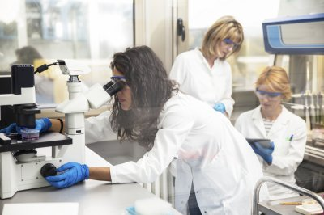
Education: The dual higher education system
School Education
学校教育
Apprenticeship
学徒制

Slide 10
Apprenticeship training
With the dual-track approach to learning, learners attend courses at vocational schools on a part-time basis. The remaining time is spent doing an apprenticeship at a host company where they are provided with the practical know-how, knowledge and skills needed for their chosen occupation. Learners also actively take part in the host company’s production processes.
Companies provide apprenticeships and traineeships, thereby paving the way for the next generation of qualified workers.

Slide 11
Innovation

Slide 12
State Visit

Slide 13
China and Switzerland forge innovative strategic partnership
Switzerland is one of the first European countries to recognize China's market economy status and the first country in continental Europe to reach an FTA with China.
Both countries aim to expand free trade and financial cooperation within the framework of the Asian Infrastructure Investment Bank (AIIB).

Slide 14
China and Switzerland forge innovative strategic partnership
After the talks, the two presidents witnessed the signing of 7 cooperative documents in the areas of vocational safety and health, low-carbon city construction and technological innovation
Per example : a cooperation between Switzerland Innovation and Tsinghua University Science Park (TusPark)

Slide 15
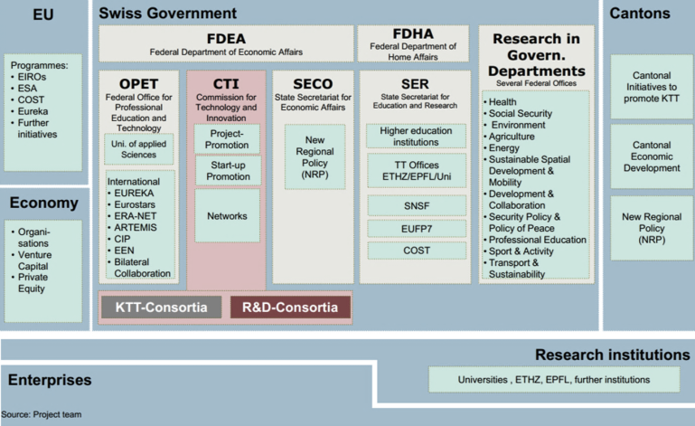
Swiss Innovation Players

Slide 16
Commission for Technology and Innovation
The CTI is mandated by the Confederation to improve the innovative strength of the Swiss economy.
It funds and supports cooperation projects between companies and higher education institutions to encourage the introduction of innovative products on the market.
It supports start-ups and thereby helps to create jobs for highly qualified workers.
It promotes the transfer of knowledge and technology between higher education institutions and Swiss companies.

Slide 17
How CTI projects are run:
CTI
Higher education
Scientific know-how
Infrastructure
Max. 50% funding (CTI funds)
Businesses
Entrepreneurial know-how
Market access, 10% cash contribution
Min. 50% funding
R&D project
Market influence

Slide 18
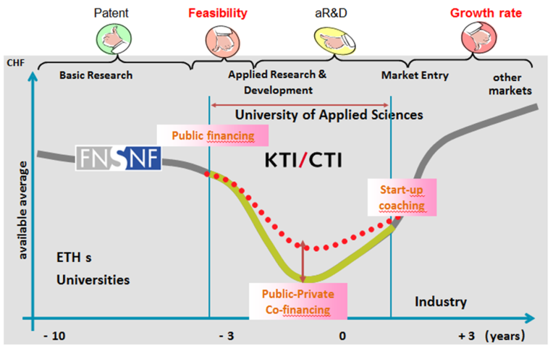
Applied R&D projects
Universities of Applied Sciences
Public financing
Start-up Coaching
ETHs
Universities
Industry
Public-Private Co-financing

Slide 19
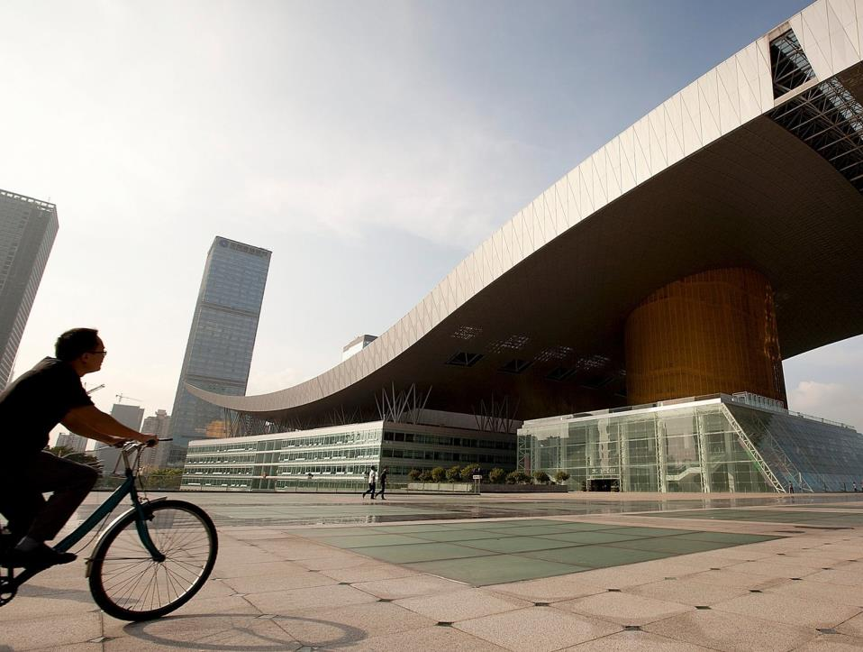
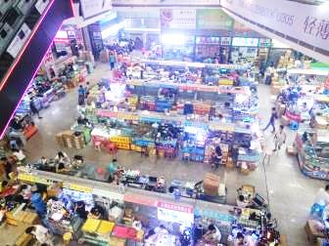
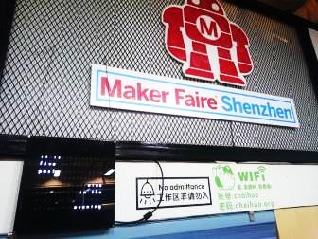
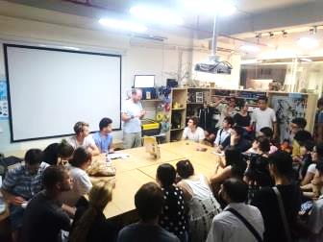
Concept of “accelerated” innovation
China Hardware Innovation Camp
From idea to prototype in 30 days
14 students, 3 teams and 30 working days… to produce 3 connected devices

Slide 20
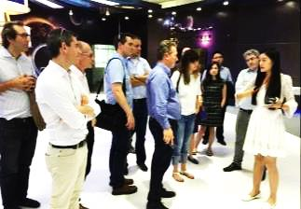
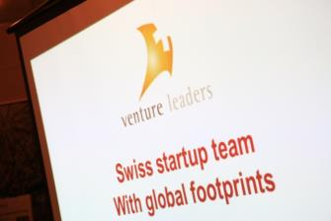
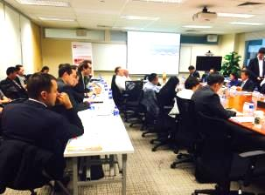
Venture Leaders
End of October 2016 : Trip in Shanghai, Beijing, Shenzhen, Hong Kong
Business development
Workshop
Networking
10 startups selected for 2016

Slide 21
HAX with Rovenso
Hardware accelerator in Shenzhen, San Francisco, and New York
Rovenso builds robots that can carry out dangerous tasks during earthquakes, landslides, hurricanes, fires or explosions.
HAX accelerator in Shenzhen:
Sillicon Valley of China
30 projects selected per year
111 days spent with one hardware project
Add funding, mentorship, lab space, DFM, and more!
Time needed to build a prototype:
3 months
9 months

Slide 22
Food innovation in Switzerland: Urban Farmers
Vision
Mission
Commercial food production system in & around cities
Operational know-how
Establish a costumer brand that guarantee to be organic, ultra-local & ultra-fresh
The ability and solutions to develop & finance commercial food production systems in cities
The operational know-how to operate & maintain highly efficient large-scale farm systems.
A leading brand that provides a price umbrella to warrant premium prices.
20% of all food should and could come from the city!

Slide 23
Comba Group
The lettuces have their roots suspended in the air and absorb the necessary water, oxygen, and nutrients from the air. The IT systems of Comba Group control the climate, and provide the right mix of water and mineral salts.
Grow in Aeroponics
10x less water than conventional agriculture
Minimum of waste and maximum of high-quality lettuce production
Optimize Space
Lettuce have their roots in the air
Maximize the production per square meter
Grow Locally, all Year-Round
Retailer distribution center
Independent of the weather, or season, for very little or no cost.
Multiply several times the number of lettuce cultivated per cycle.

Slide 24
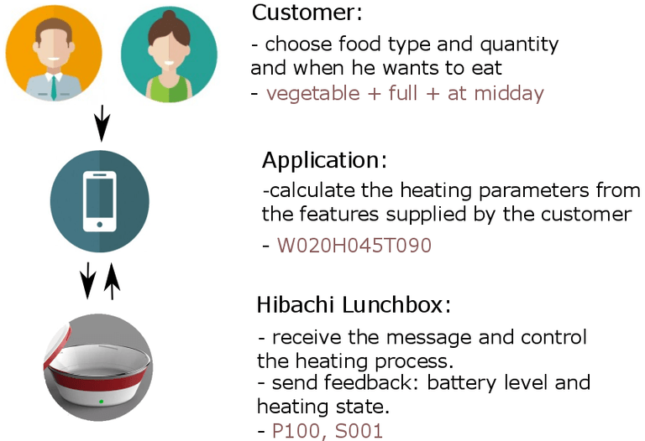
Hibachi
Heabox is a connected portable lunchbox that brings your food to suitable temperature for consumption.
The lunchbox would allow to carry a meal and bring it to a comfortable temperature for eating, using energy from a battery.
An App would serve as an interface for set up personalized features of the box such as heating scheduling or heating power.

Slide 25
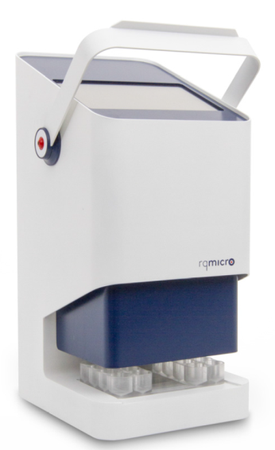
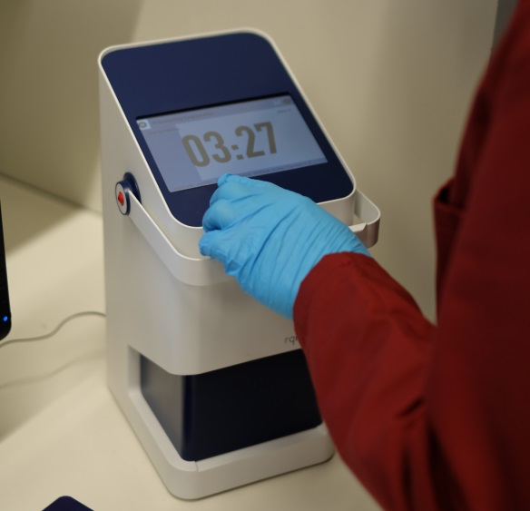
RQ-Micro
1 hour
Developed a pathogen separation and detection technology that delivers accurate results in less than 1 hour
Benefit
Ultrafast separation of microorganisms from complex samples
Real-time detection and quantification
Automated workflow for an site testing

Slide 26
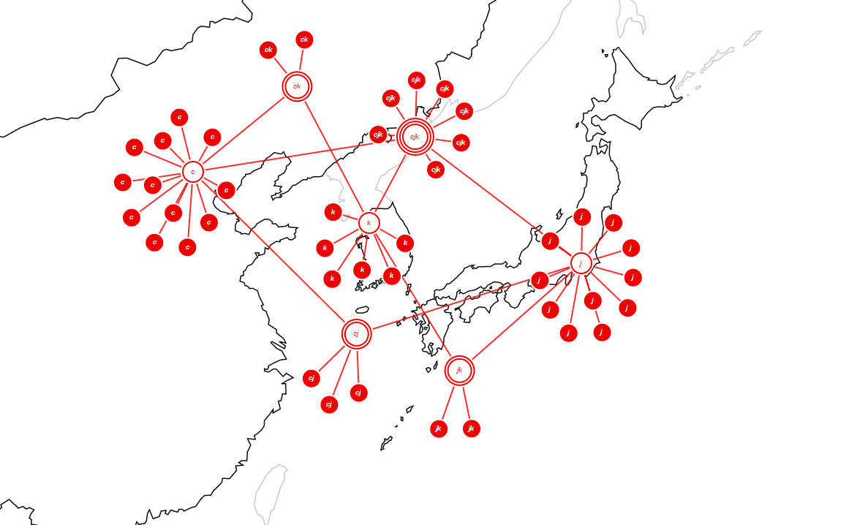
S&T office Asia

Slide 27
Thank you! 谢谢！

