Slide 1
Incredible ideas to credible businesses – the journey through start up and incubation
Paul Field

Slide 2
Content
Changing the enterprise culture and alignment of supportive eco-systems
Technology Innovation & Entrepreneurship Programme
Combining incubation and enterprise - ‘Encubation’
Huddersfield University support models:
  3M BIC
  DOYYEC
  EAGLE LAB
  Y ACCELERATOR
  TANi
Notes:
Aspirational goals, work in progress and a culture change through the organisation but also the external organisations in relation to their impact goals. There are academic entrepreneurs but others not aligned with this approach, however there is no one size fits all templates.

Slide 3
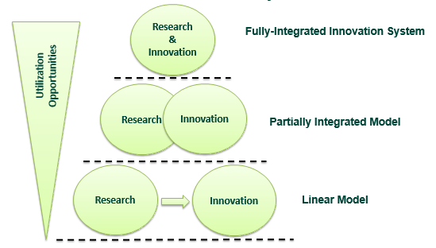
Utilization-Focused Innovation System
Notes:
Huddersfield University is an applied university. ..background ..and a focus on strategic research. In particular strategic research can support education, commercialization, and utilization simultaneously .. comprehensive knowledge management and IP strategy compromises the ability to capture, re-use, automate, manage, and exploit knowledge. However university patenting is still reactive rather than strategic. This requires the university to be wired and connected to the relative commercial areas and partners. The outcome is technology push. Academic patents looking for a market. We are advocating that when a research grant application is completed, consideration is also given to the potential commercial opportunities, industry problems, players in the industry, a dual hypothesis approach, and even a prior art search completed at this stage.
There are continuous conflicts which as yet no system has resolved, publications agenda for example. But scientific research is hypothesis driven , you’re guessing and then trying to prove it true or false, and commercialisation is not that much different
But being a great designer or engineer are not enough to win commercially, different facets are in play and commercialisation support is essential and the concept of eco-systems is important: the entrepreneurial conditions beyond university walls affect how proactive an institution can be. However we do know that more research leads to more commercial opportunities

Slide 4
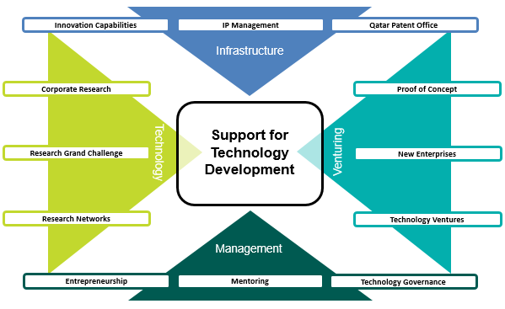
SME support eco-system Qatar
Notes:
Whilst there maybe similarities with others, a country, region or organisation needs to tailor what works best within its own environment. For example, Qatar did not have a patent office, limited VC and human resource capability so specific programmes were needed to plug these gaps. Research networks needed to be stimulated and funds such as the Qatar National Research Fund established. We needed to establish Pre‐incubation to support the potential entrepreneur in developing his business idea, business model to boost the chances to arrive to an effective start‐up creation. Incubation as a highly flexible combination of business development processes, infrastructure and people designed to help nurture new business ideas by helping them to survive and grow through the difficult and vulnerable early stages of development.

Slide 5
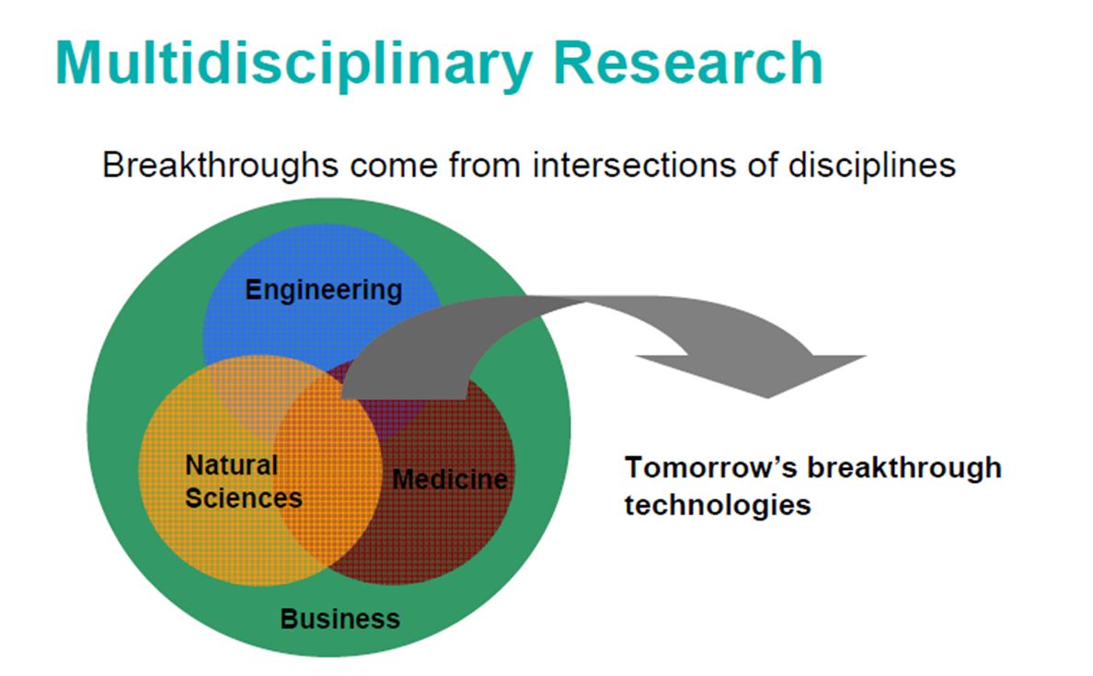
Interactive Model
Notes:
The university and government grants encourage faculty to work not in silos but interactive. Changing the methods of research and widening of collaboration increases the innovative contribution. For example, we are establishing the digital health zone and establishing a national physical laboratory for industry and academia.

Slide 6
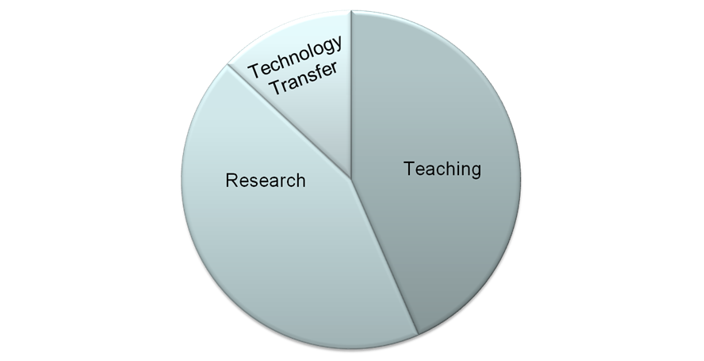
Traditional approach
Notes:
Traditional model, third leg, Thus the main goal of researchers has been and continues to be the publication of research in peer-reviewed journals towards primarily a scientific audience. The ivory tower research paradigm must be replaced with a new ethics of utilization whereby researchers together with partners in the innovation system consciously manage the utilization of research results instead of simply waiting on serendipity.
Most university patents are still reactive rather than strategic, in that patent filing tends to be considered only when a disclosure is near or complete. However as in the utilisation model businesses can influence research focus and development with a strategic goal in place. Another conflict is research verses development, as credit goes more to the experimental research then development especially beyond proof of concept.

Slide 7
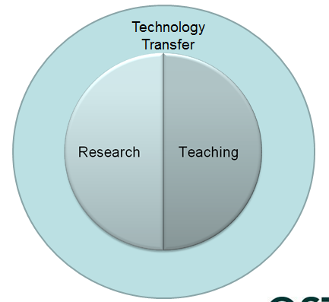
Notes:
This latter approach is the key to developing an enterprise culture within a university sector. Its not so much as to make every research project and each lecture or assignment an exercise in commercialisation, but having the ability to recognise where and when commercialisation opportunities exist, and then realising their intrinsic value. In a KBE-focused Innovation System the core research processes are altered to accelerate utilization by the inclusion of an intellectual property and knowledge management approach, As utilization of research is the main focus, the research strategy is not only governed by scientific enquiry but also by economic and social development priorities. While publication is still an important aspect of the system, research results are governed by an IP policy and processed as potential intellectual assets and property in parallel to publication considerations. A utilization approach relies on highly competent IP management capabilities not only to package research results but to also advise research strategy (Strategic IP) and manage research collaborations (Open Innovation) in a strategic manner. To build a successful KBE-focused Innovation System research ideology, policy, procedure, and incentives must be aligned with social and economic goals, which could broadly be described as the new ethical paradigm for research. Though a utilization focus always asks the question – How do the results of research advance social and economic goals? – this is equally relevant for basic and applied research as the question encompasses both short and long term benefits. The university of Huddersfield is now implementing enterprise for every discipline for every stage. From copyright via IT and musicians to patenting and design registrations. So there is some exposure for every student and it is anticipated for every academic with recruitment focused on early stage researchers interested in the juxtaposition of aligning research and enterprise.

Slide 8
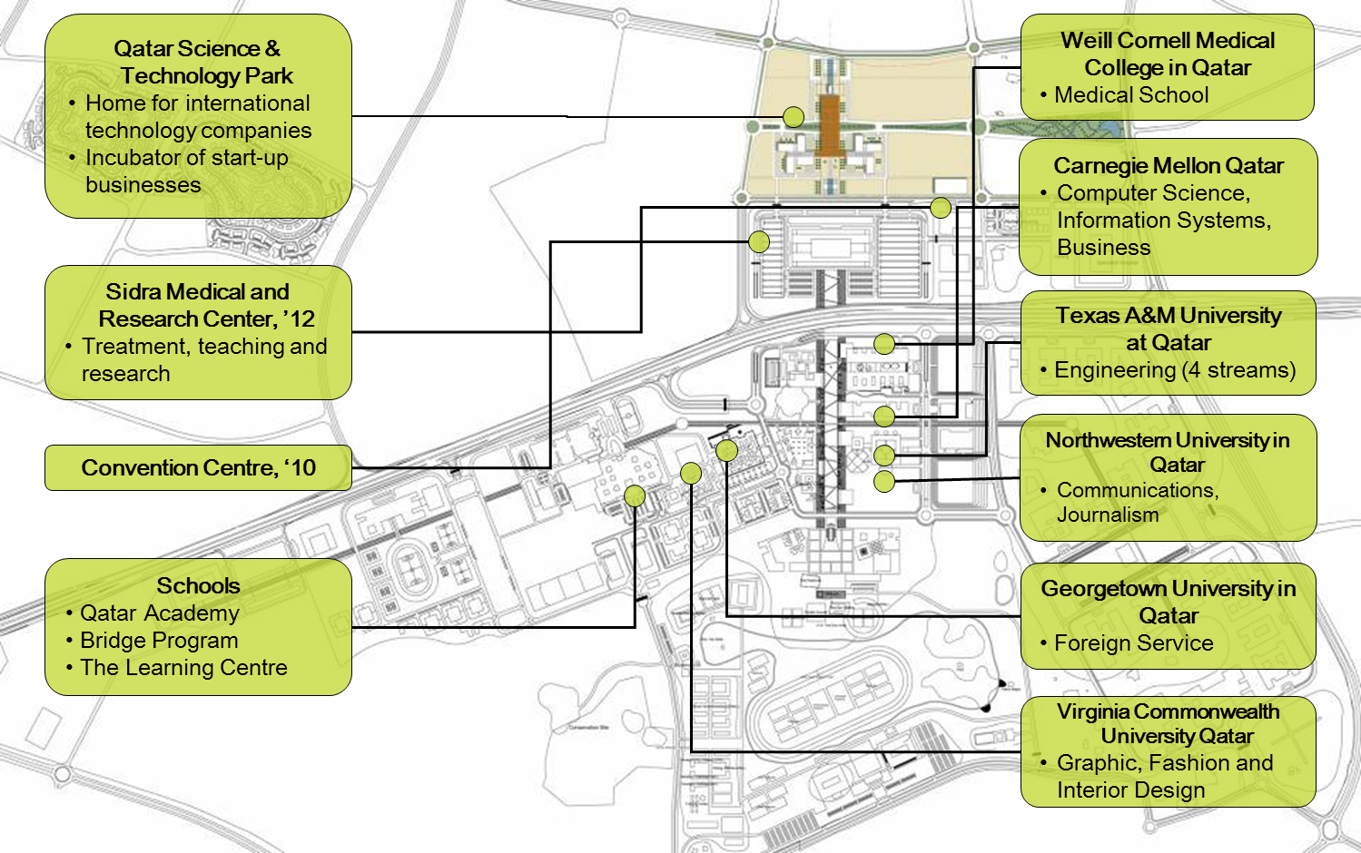
Education City - Qatar
Notes:
Maximising value creation by linking the objectives of the national vision strategy so mirroring and supporting its development. This increases serendipity for organisations to collaborate, new starts were provided with visas, free zones, branch status, reducing bureaucracy and barriers to entry. For overseas starts offices and accommodation facilities were simultaneously provided leaving the company to focus on its development, rather than being distracted by non value adding exercises. Try and accommate and view everything from the client perspective.

Slide 9
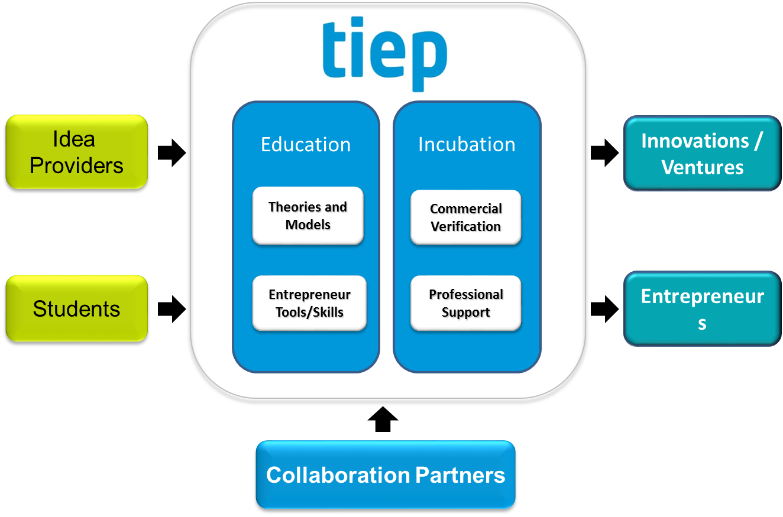
Process of incubation
Notes:
A learn-by-doing approach was adopted. The technology innovation entrepreneurship programme was developed. The environment was new and even research development and undergraduate programmes were nascent. Students ie actual students, company employees or academics were enrolled on the support programme at differing stages, pre proof of concept, pre commercialisation or even without their own ideas! Flexible and adaptable to the client needs.

Slide 10
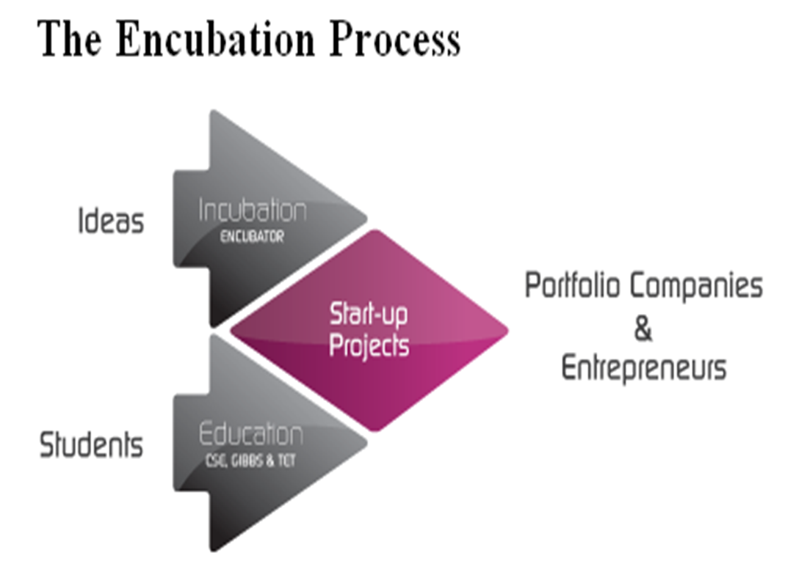
Encubation

Slide 11
Encubator activities
Project recruitment/evaluation
Incubator office (infrastructure) or virtual
Seed-capital
Business advice/coaching
Professional network(advisors/consultants)
Board representation, appoints chair/working groups
Company formation
Active shareholder/supporting the entrepreneurs

Slide 12
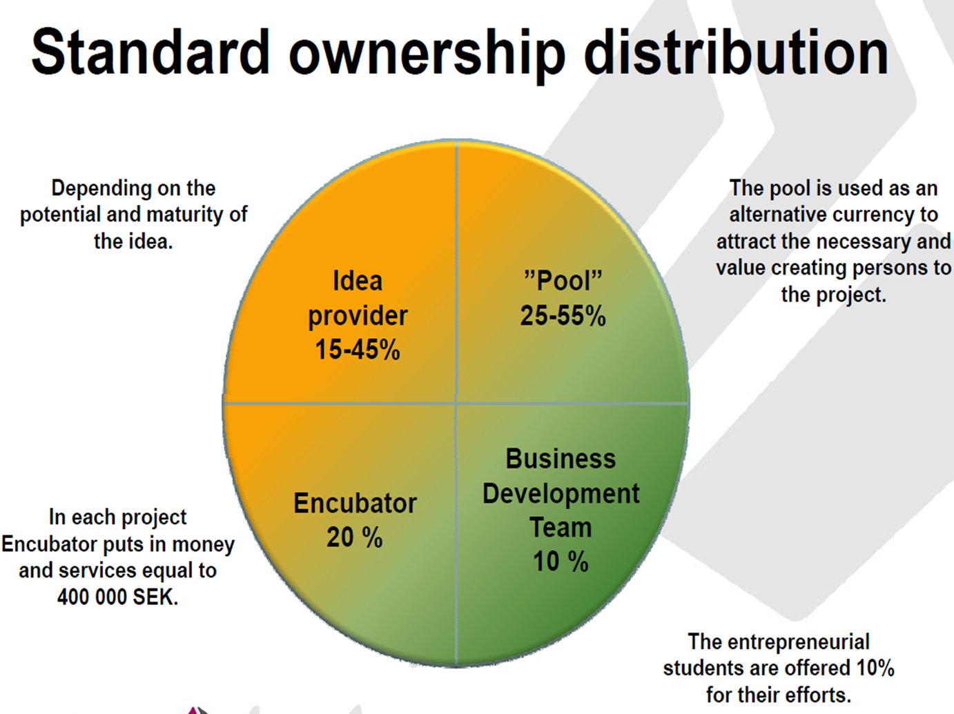
Ownership

Slide 13
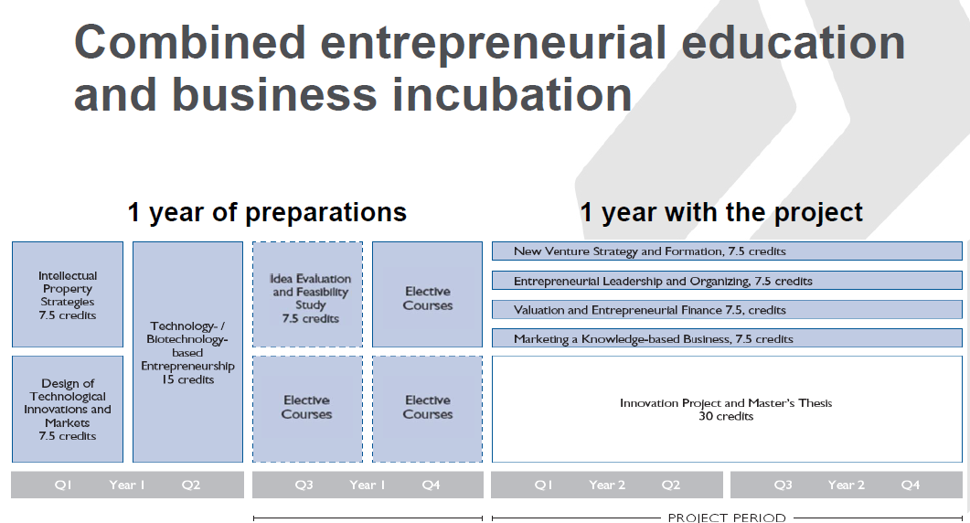
Notes:
Encubator was initiated in 2001 to.. 1.Increase commercialization 2.Enhance the learning process 3.Take part of the value created

Slide 14
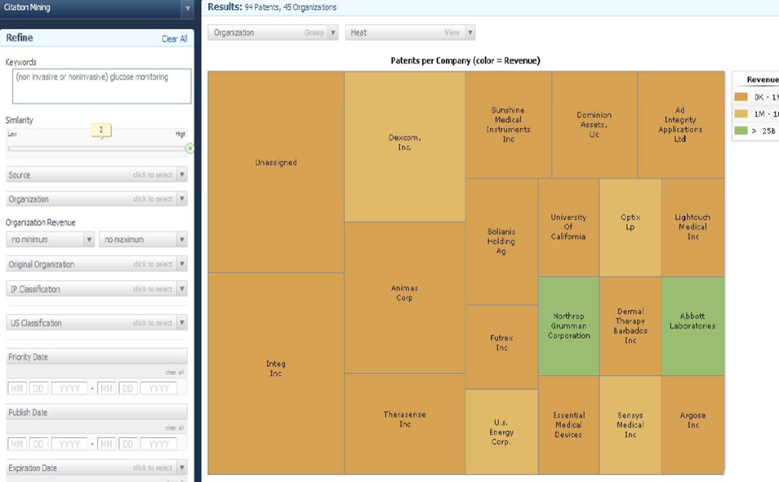
Innography – competitor landscapes
Identify competitors in technology market and determine ownership position

Slide 15
Business model canvas

Slide 17
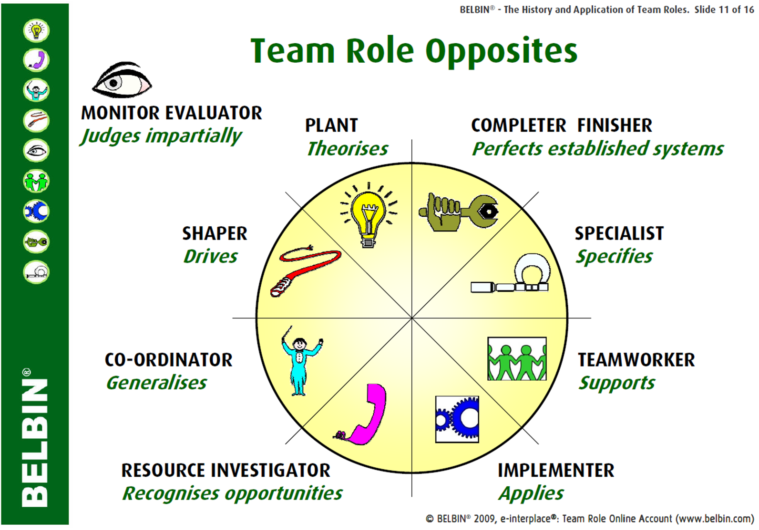

Slide 18
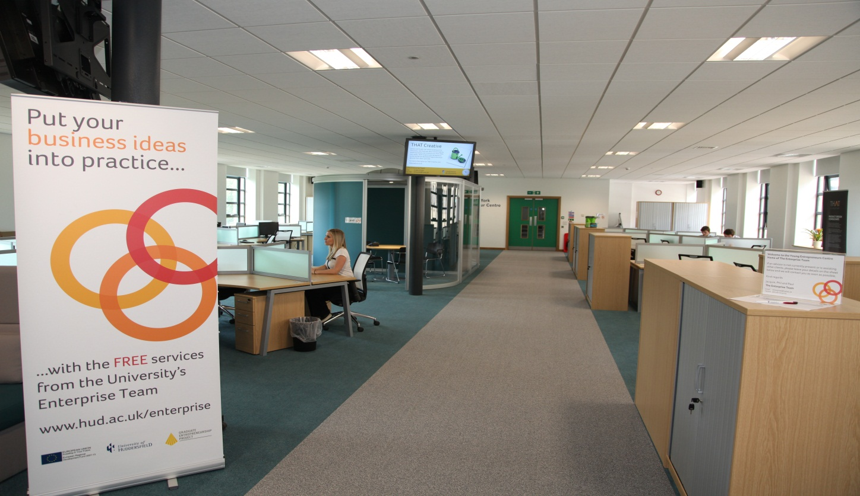
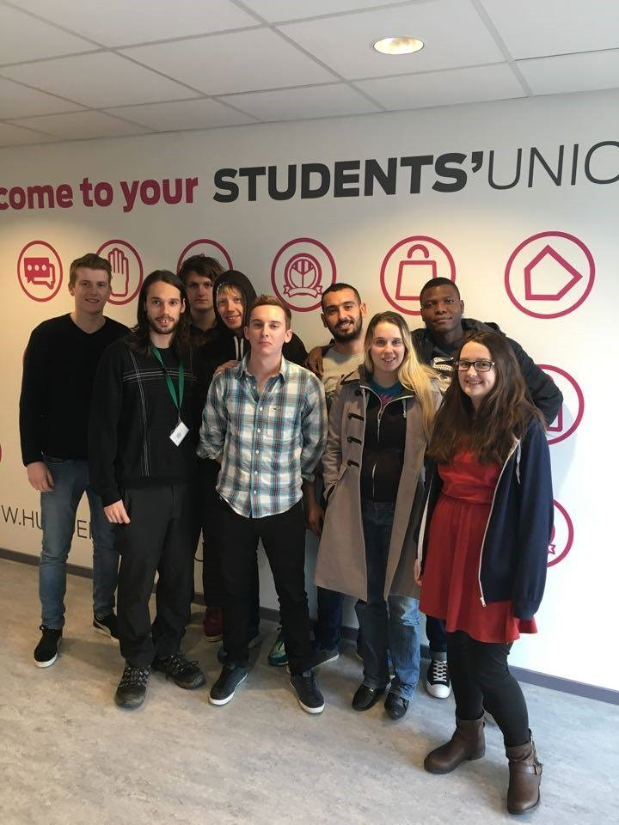
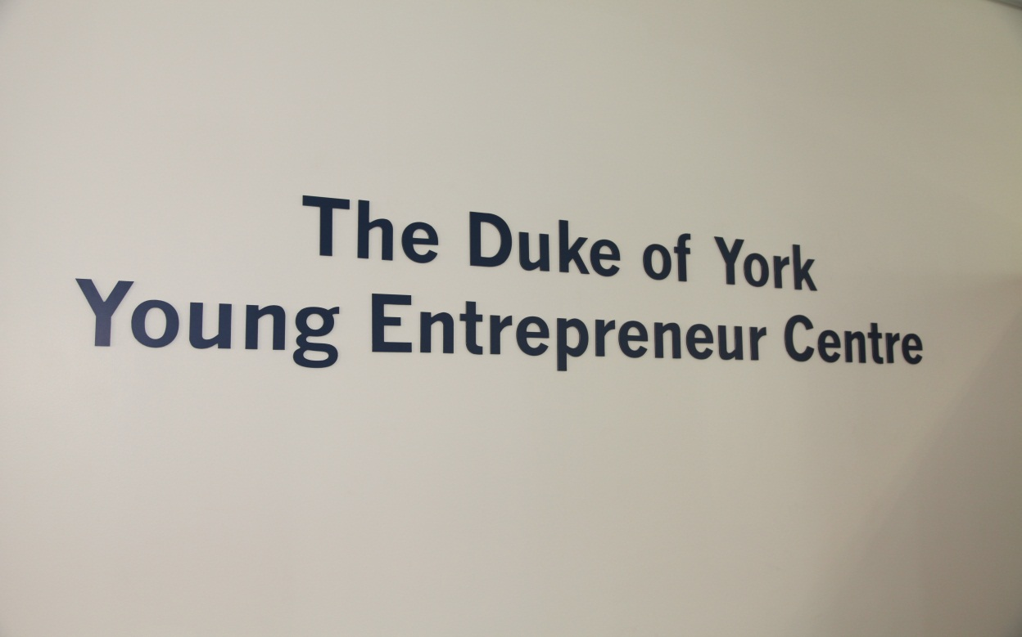
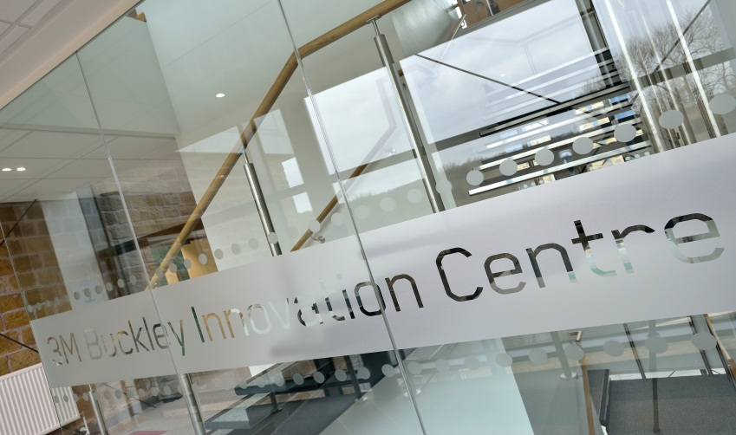

Slide 19

Huddersfield Eagle Lab: Shared Aims
to create a digitally-focused space, containing a flexible hybrid of functions, that will inspire the next generation of students and entrepreneurs into a career in making and manufacturing.
to create a world class facility that acts as a hub for the Huddersfield’s digital and ‘maker’ community, inspiring them to create, innovate and grow whilst complimenting the existing local ecosystem
four core functions:
Discovery
Incubation
Business engagement
Maker Space

Slide 20

Huddersfield Eagle Lab: Core Functions
Business engagement
Maker Space
Discovery
Added value services for SME’s through access to the Maker Space, Incubator and Discovery activities
A “go to” space for innovative companies keen to network and forge new alliances
A venue to access business support advice and specialist business products and services from Barclays
A pathway to facilitate introductions for innovative businesses to potential collaboration opportunities at the University
Empowering the community to make and design things themselves
A practical and ‘hands-on’ educational facility that brings manufacturing, design and digital to life
Focus on entry level, design & prototype manufacturing capability
Inspiring and educating the community around modern Science Technology and Manufacturing (STEM)
Complementing existing technology pathways eg. more advanced tools available at the University / 3MBIC
A facility to fuse the disciplines of Art and Design with STEM
Incubator Space
Creating an infrastructure that allows local entrepreneurs and high potential start-ups the best chance of succeeding
Access to Lab equipment, desk and office space and conferencing facilities
Facilitating access to experts in areas including start-ups, finance and technology

Slide 21
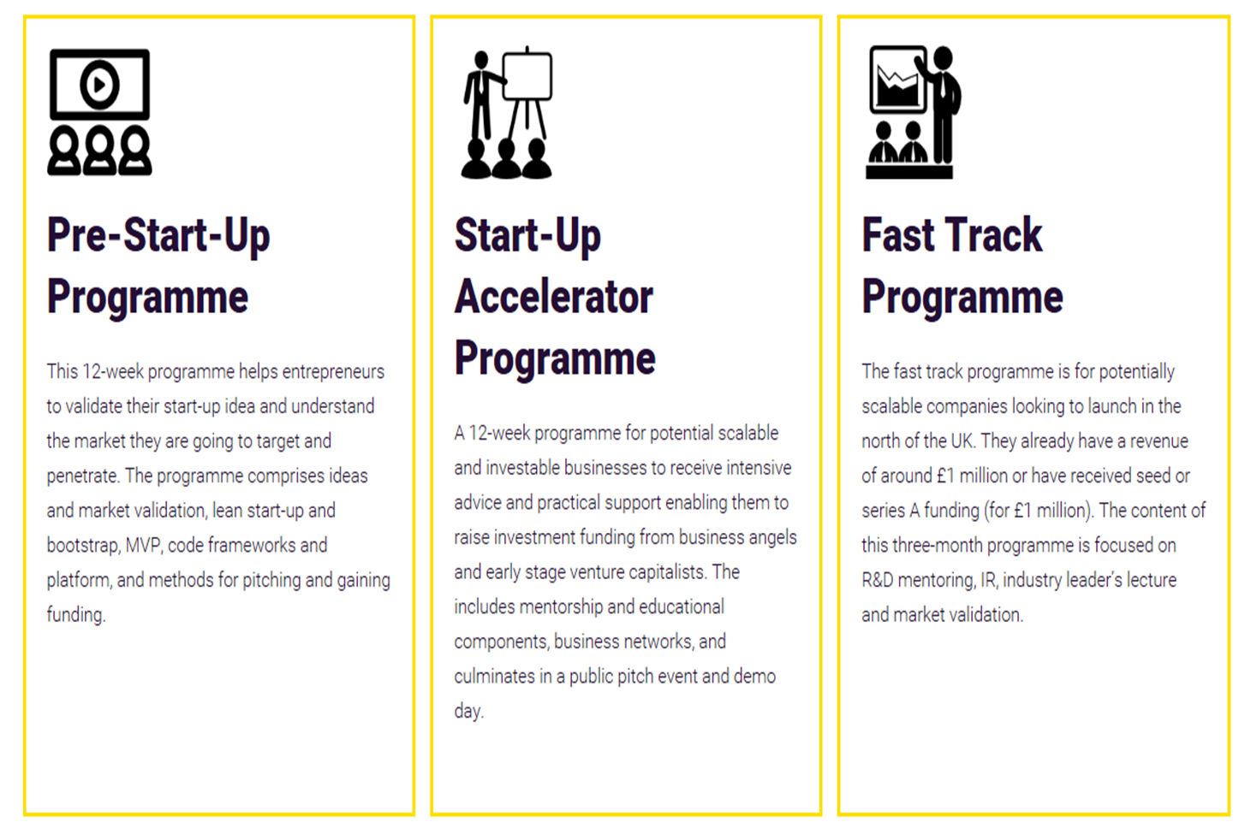
International Accelerator

Slide 22
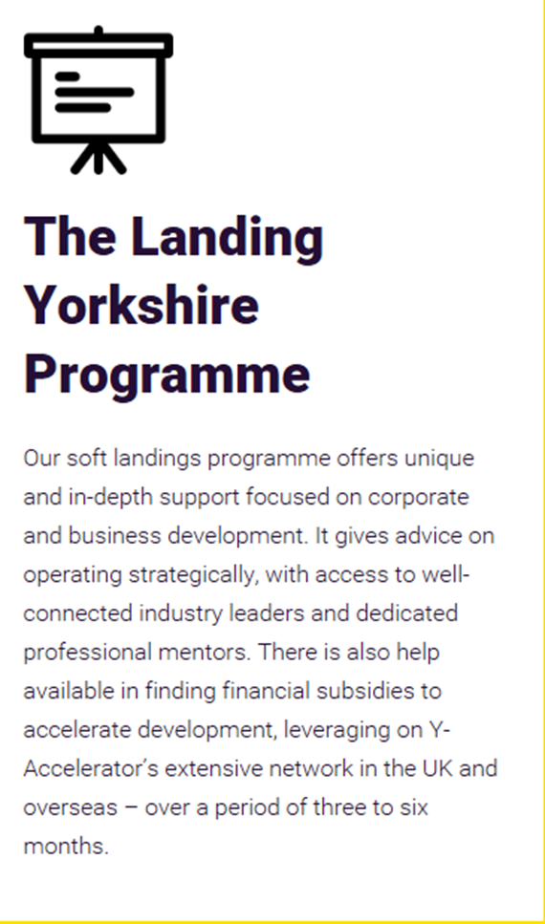
International Accelerator

Slide 23
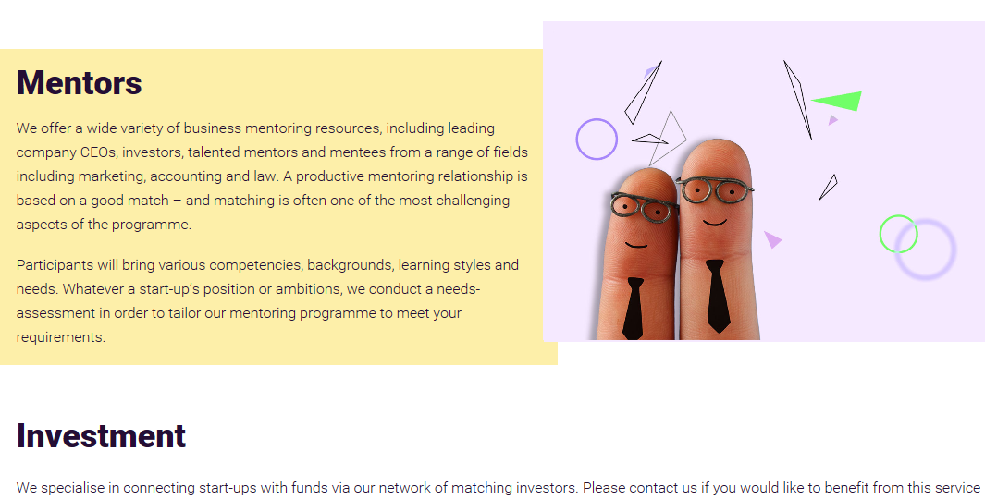

Slide 24


Slide 25
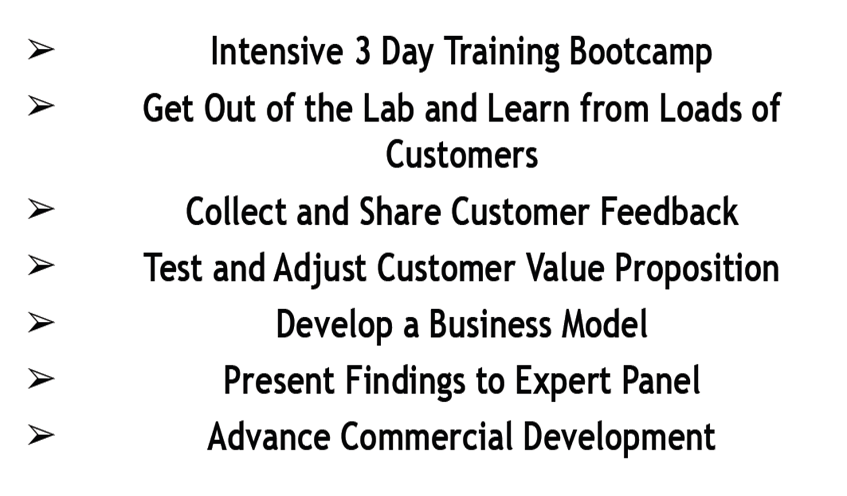
Business hackathons – 48 hours

Slide 26
The Accelerator Network (TAN)
Significantly increasing the quality and quantity of investable high growth technology start-ups for economic development organisations globally.

Slide 27
About TAN
Developing start-up ecosystems that produce MORE innovative, scalable, investable companies.
TAN helps you to generate higher levels of entrepreneurial activity thus increasing social and economic wealth in your community.
Our frameworks provide proven, market-tested education and support for every step of the entrepreneur and investor journey from idea right though to scale-up.
And these programs work: 85% of start-ups that have participated in TAN frameworks have reached their funding

Slide 28
TAN Approach
TAN provides a unique approach to improving the performance of startup communities
We integrate and connect our process to your existing resources and institutions, transferring expertise and knowledge to increase start-up creation, sustainability and investment activity.
With a starting point that includes analysis of your existing activity to provide a clear understanding of your goals, environment and culture, we tailor our chronological system of support to deliver significant improvement to you, your investor and entrepreneur community.
All of our activity has the same goal: identification and growth of innovative, investable, scalable companies.
Notes:
1. Innovation Mapping: analysis of your current activity, environmental and cultural factors that impact startup creation and investor appetite. This process establishes a baseline and defines success.
2. Inform: Events that provide an opportunity for inquisitive potential entrepreneur and investor audiences to learn and be inspired.
3. Innovation Challenges: Hackathons, startup competitions and corporate venture development all designed to connect entrepreneurs to first customers and investors
4. Education: created in conjunction with University College London our “entrepreneur MBA” prepares startup teams for application to some of the world’s best accelerator programmes and for seedcorn investment rounds.
5. Acceleration: Our 12-week bootcamp for advanced technology startups looking to raise £500k+
6. Access to Funding: Our Accelerator Funding Network improves access to funding for startups exiting from our accredited programmes and provides investors with education, visibility and access to pre-vetted startups.
7. Investment Funds: Our Accelerator Funds provide co-investment fund management expertise to plug the equity gap between £400k - £2m providing risk mitigation to both investors and startups.
All of our stages are tailored to YOUR own environment to ensure a culture-fit for your entrepreneurs and investors.

Slide 29
Incubation Strategy – final thoughts
Acknowledge the changing needs of clients over time
Assess the quality of external service provision
Demonstrate where new client flow will come from
Ensure objectives inform the delivery of incubation processes
Focus on ways to measure and monitor impact on the wider economy.
Identify on methods to assure the quality of business development resource provision
Identify the range of business development resources and, where appropriate, facilities and infrastructure which will be provided to help clients achieve their true growth potential
Identify ways for the incubator to act as a catalyst for economic development.
Map out a critical path for the development of the incubation environment

Slide 30
Thank you for listening
Contact : P.Field@hud.ac.uk

Slide 31
Notes:
Traditional model, third leg, Thus the main goal of researchers has been and continues to be the publication of research in peer-reviewed journals towards primarily a scientific audience. The ivory tower research paradigm must be replaced with a new ethics of utilization whereby researchers together with partners in the innovation system consciously manage the utilization of research results instead of simply waiting on serendipity.

Slide 32
Notes:
Traditional model, third leg, Thus the main goal of researchers has been and continues to be the publication of research in peer-reviewed journals towards primarily a scientific audience. The ivory tower research paradigm must be replaced with a new ethics of utilization whereby researchers together with partners in the innovation system consciously manage the utilization of research results instead of simply waiting on serendipity.

Slide 33
QSTP’s Position in the Research & Innovation Value Chain
QSTP operates across the research and innovation value chain by:
  linking early research with commercialisation
  interfacing between the outputs of scientific research and its application
  managing intellectual property assets
  engaging in active network relationships
Universities
QNRF
QSTP
Industry
Industry
Basic Research Demonstration Wealth Creation
Notes:
Wealth: water, energy, agriculture, land, technology, and health.
33

Slide 34
Incubation strategy
Acknowledge the changing needs of clients over time
Assess the quality of external service provision
Demonstrate where new client flow will come from
Ensure objectives inform the delivery of incubation processes
Focus on ways to measure and monitor impact on the wider economy.
Identify on methods to assure the quality of business development resource provision
Identify the range of business development resources and, where appropriate, facilities and infrastructure which will be provided to help clients achieve their true growth potential
Identify ways for the incubator to act as a catalyst for economic development.
Map out a critical path for the development of the incubation environment

Slide 35
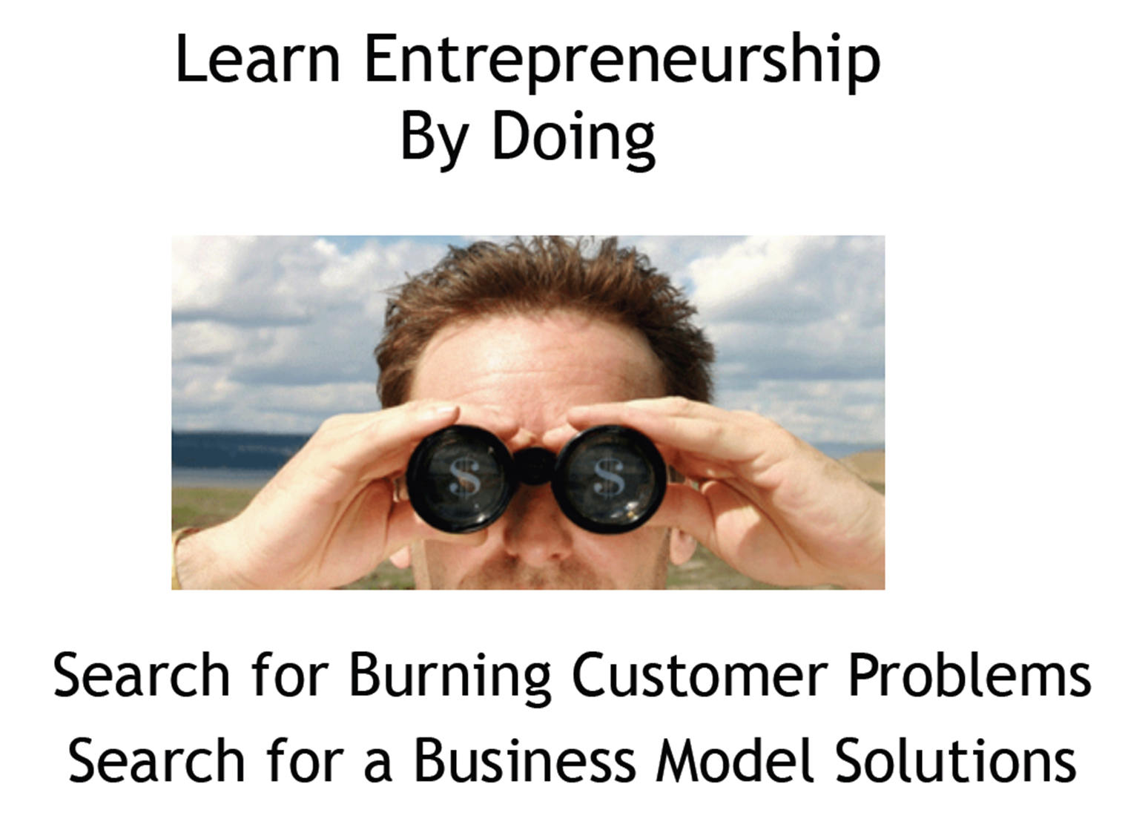
Notes:
Traditional model, third leg, Thus the main goal of researchers has been and continues to be the publication of research in peer-reviewed journals towards primarily a scientific audience. The ivory tower research paradigm must be replaced with a new ethics of utilization whereby researchers together with partners in the innovation system consciously manage the utilization of research results instead of simply waiting on serendipity.

Slide 36
QSTP – Maximizing Value Creation by Linking with Qatar National Vision
Human Development
Social
Development
Environmental
Development
Economic Development

Slide 37
Applied Research in Line with National Goals
Energy
Environment
ICT
Health Sciences

Slide 38
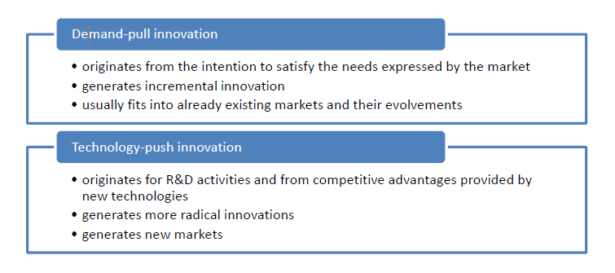

Slide 39

Innography- Competitor landscape
Refinement of search results
Identify competitors in technology market and determine ownership position

Slide 40
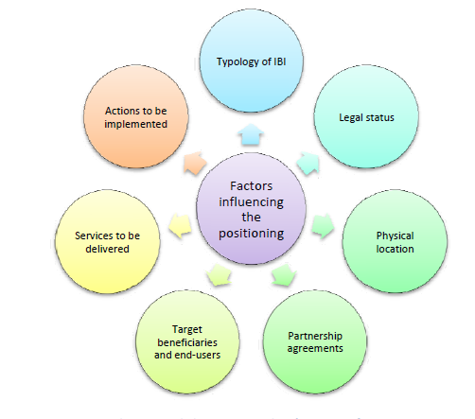
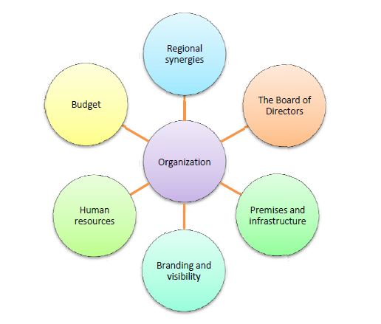
Set up and organisational issues

Slide 41
Diagnostics/tools
SWOT
Innovation Gaps
BMC
Accounting software
Customer software management
Connectivity

Slide 42


Slide 44
The Accelerator Network - TAN
(International)
Significantly increasing the quality and quantity of investable high growth technology start-ups for economic development organisations globally.

Slide 45
TAN Approach
TAN provides a unique approach to improving the performance of startup communities
We integrate and connect our process to your existing resources and institutions, transferring expertise and knowledge to increase start-up creation, sustainability and investment activity.
With a starting point that includes analysis of your existing activity to provide a clear understanding of your goals, environment and culture, we tailor our chronological system of support to deliver significant improvement to you, your investor and entrepreneur community.
All of our activity has the same goal: identification and growth of innovative, investable, scalable companies.
Notes:
1. Innovation Mapping: analysis of your current activity, environmental and cultural factors that impact startup creation and investor appetite. This process establishes a baseline and defines success.
2. Inform: Events that provide an opportunity for inquisitive potential entrepreneur and investor audiences to learn and be inspired.
3. Innovation Challenges: Hackathons, startup competitions and corporate venture development all designed to connect entrepreneurs to first customers and investors
4. Education: created in conjunction with University College London our “entrepreneur MBA” prepares startup teams for application to some of the world’s best accelerator programmes and for seedcorn investment rounds.
5. Acceleration: Our 12-week bootcamp for advanced technology startups looking to raise £500k+
6. Access to Funding: Our Accelerator Funding Network improves access to funding for startups exiting from our accredited programmes and provides investors with education, visibility and access to pre-vetted startups.
7. Investment Funds: Our Accelerator Funds provide co-investment fund management expertise to plug the equity gap between £400k - £2m providing risk mitigation to both investors and startups.
All of our stages are tailored to YOUR own environment to ensure a culture-fit for your entrepreneurs and investors.

Slide 46
About TAN
Developing start-up ecosystems that produce MORE innovative, scalable, investable companies.
TAN helps you to generate higher levels of entrepreneurial activity thus increasing social and economic wealth in your community.
Our frameworks provide proven, market-tested education and support for every step of the entrepreneur and investor journey from idea right though to scale-up.
And these programs work: 85% of start-ups that have participated in TAN frameworks have reached their funding

